Slide 1

Sensitivity to Noise Nuisance in London
Applied Data Science
Pratik Watwani

Slide 2
Noise - Far beyond annoying
WHO : Anything more than 55 dB - > harmful for human health!
However, in London:
More than 1.6 million people in the city are exposed to road traffic noise levels during the day above 55 dB
Scientists found deaths were 4% more common in adults and the elderly where the daytime traffic noise was more than 60 dB compared to less than 55 dB
The increase in the number of deaths are most likely linked to heart or blood vessel disease, possibly due to increased blood pressure, sleep problems and stress from the noise.
[1] Jaana I. Halonen, Anna L. Hansell, John Gulliver, David Morley, Marta Blangiardo, Daniela Fecht, Mireille B. Toledano, Sean D. Beevers, Hugh Ross Anderson, Frank J. Kelly, Cathryn Tonne, Road traffic noise is associated with increased cardiovascular morbidity and mortality and all-cause mortality in London, European Heart Journal, Volume 36, Issue 39, 14 October 2015, Pages 2653–2661, https://doi.org/10.1093/eurheartj/ehv216

Slide 3

Motivation
Exposure to noise can cause disturbance and interfere with activities, leading to annoyance and increased stress. For many people, a sense of tranquillity contributes to their enjoyment of the natural environment and work efficiency.
However, the tolerance of noise and willingness to report can be different regarding the demographics of different areas, such as their working situations, education level and etc.
[1] Jaana I. Halonen, Anna L. Hansell, John Gulliver, David Morley, Marta Blangiardo, Daniela Fecht, Mireille B. Toledano, Sean D. Beevers, Hugh Ross Anderson, Frank J. Kelly, Cathryn Tonne, Road traffic noise is associated with increased cardiovascular morbidity and mortality and all-cause mortality in London, European Heart Journal, Volume 36, Issue 39, 14 October 2015, Pages 2653–2661, https://doi.org/10.1093/eurheartj/ehv216

Slide 4
What is Sensitivity?
sensitivity =
rate of complaints of noise
rate of exposure to noise

Slide 5
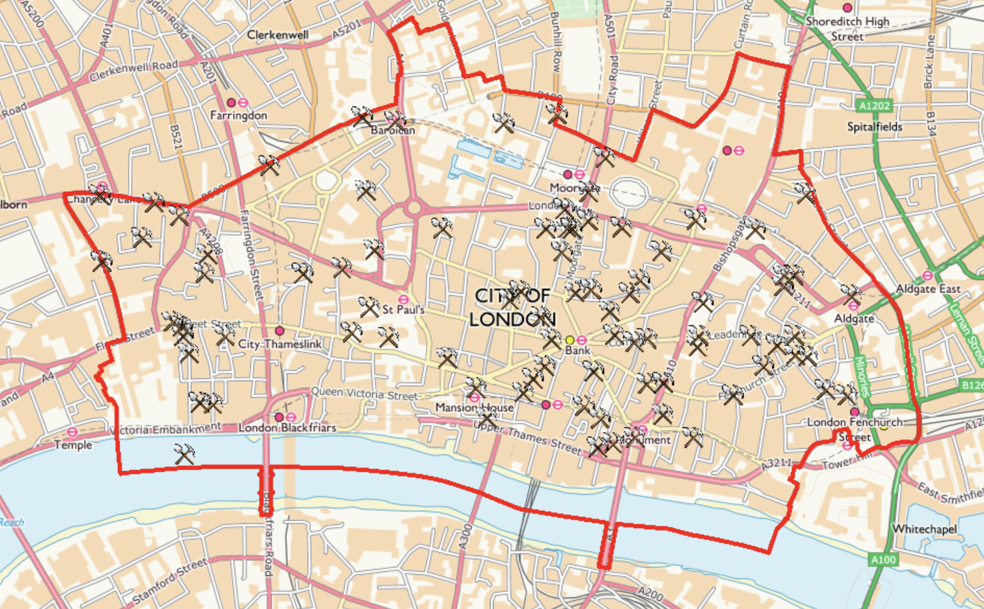
Current Scenario
Construction work is one of the major driving factors of noise nuisance in the city of London, and evidently a significant number of deaths.
The increase in the number of deaths are most likely linked to heart or blood vessel disease, possibly due to increased blood pressure, sleep problems and stress from the noise.
Source: Interactive Mapping, London.
https://www.mapping.cityoflondon.gov.uk/geocortex/mapping/?viewer=compass&runworkflowbyid=Switch_layer_themes&LayerTheme=Show%20the%20Construction%20Variations%20layers

Slide 6
Are certain demographic characteristics responsible for sensitivity to noise complaints?

Slide 7
Objective
To recognize if there exists a pattern considering a variety of their demographic characteristics (income, gender, education, etc.) in the population that specify their sensitivity to tolerating and reporting noise nuisance.

Slide 8
Literature Survey
According to MIT Senseable Weibo research, demographic characteristics play a notable factor in societal and environmental issues. Their study demonstrated how income levels, type of activity, and the resident type can alter sensitivity levels.[1]
An independent research carried out by Cirrus Research PLC, of the 32 boroughs in London, 20 of them have have repeatedly reported noise nuisance. With only 8,072 residents living in financial district, 1022 complaints were reported.[2]
Cirrus Research’s study makes a strong stand that elderly people are more likely to complain about noise nuisance. [2]
[1] http://senseable.mit.edu/weibo_smog/
[2] https://www.cirrusresearch.co.uk/blog/2017/03/london-hotspots-noise-nuisance-complaints-infographic/

Slide 9
Data and Method
Data collection and preprocessing:
Public Health England
Demographics:
Population
Employment
Income
Designated Green Belt Land
Educational Qualification
3. Exploratory Data Analysis to find preliminary observations
4. Regression analysis
5. Test for correlations, hypothesis testing and visualization

Slide 10
Q&A

